Slide 1
Bipolar Disorder

Slide 2
TABLE OF CONTENTS
The case
Literature review
Introduction
Causes & Risk factors
Epidemiology
Symptoms
Subtypes
Bipolar in children
Treatment & Prognosis

Slide 3
HISTORY
P COMPLAIN: “I have depression and failed to take my medication 4/7”
H P COMPLAIN: she is lala touray, a45yr old wolof who lives at serekunda london and she is married. She was a waitress later a business woman. She was referred from polyclinic to tanka tanka hospital and has been on admission for 3weeks. She has:
Increased energy
Talks a lot
Increased activity
people cast a spell on her
Over excited,
speak with increased energy

Slide 4
saying many things at same time
Restless
No fatigue
No constipation
No hallucination or illusion
CURRENT MEDICATION: she is on:
  Haldol(oral)
  Largatil(oral)
  Modecate(parenteral)
  Artane(oral)
PAST PSYC HISTORY: her first episode occurred in 1992 were she was admitted in Europe.
she was stable for sometime, came back to the Gambia work as a cashier. at tanka tanka on several occasion

Slide 5
PAST MED HISTORY: had a miscarriage were D&C was done
FAMILY HISTORY: she is from a family of 6, she is the the first born with 3 siblings all of which are alive
no family hx of similar symptoms or any psychiatric illness
family has a hx of thyroid disease
PERSONAL HISTORY: she had a normal childhood development
attended to form 4 level(high school)
she was in Europe for some time
she worked as a waitress and later as a clerk, currently not engaged

Slide 6
RELATIONSHIP HISTORY: she is married to a black swedish
SUB USE HISTORY: denies using any substances but smokes cigarette for 30yrs
FORENSIC HISTORY: never been arrested, convicted or sentence to court
CUR SOCIAL HISTORY: she lives at serekunda london with her mother and younger brother
Has good social contact
PREMORBID HISTORY: could not be determine

Slide 7
MENTAL STATE EXAM
APPEARANCE: she looks older than her age with an assume weight of 50kg and a height of 1.6m
She is neat with no colourful or bizzare dressing, has a good self care
She has no rash but has nicotine stains
BEHAVIOUR: normal gait, no abnormal movemnt
Good eye contact
psychomotor agitation
Not very cooperative
Talkativeness(loquaciousness)
SPEECH: had pressure of speech

Slide 8
MOOD & AFFECT: euphoric
THOUGHT(content): persecutory delusions
Incoherence
No phobias, no obsession
(process)
Has flight of ideas
No word salad
No ratarded thinking
PERCEPTION: No hallucination
No illusion
No pseudohallucination

Slide 9
COGNITION: she is concious but hyperalert
Oriented to person, place and time
Attentive with good memory
No sucidal thought or attempt
INSIGHT: have good insight and is motivated to take treament
RISK ASSESMENT
TO SELF: none(no sucidal attempt/thought)
TO OTHERS: none(no hx of homicide, not aggressive)
FROM OTHERS: none (no aggression, no hx of violence)

Slide 10
DIAGNOSIS: bipolar disorder in manic episode
DIFF DIAGNOSIS: Schizophrenia
Drug induced psychosis
major depression
INVESTIGATION: TSH, T3 and T4, MRI
PROGNOSIS: good, although is a chronic disease but she has good insight, no forensic hx, no sucidal thought/attempt
TREAMENT: Inpatient- mood stabilizer(lithium 400mg) tab carbamazepine 200mg
Benzodiazepine(tab lorazepan 3mg)
antipsychotic, electroconvulsion
Antidepresssant(imipramine, fluoxetine)
psychotherapy(cognitive and individual behavioral theraphy)

Slide 11
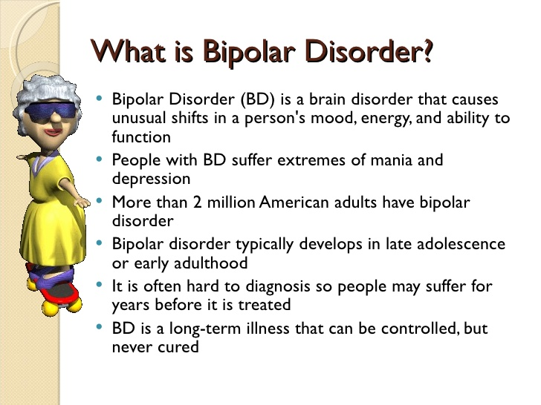

LITeRATURE REVIEW

Slide 13
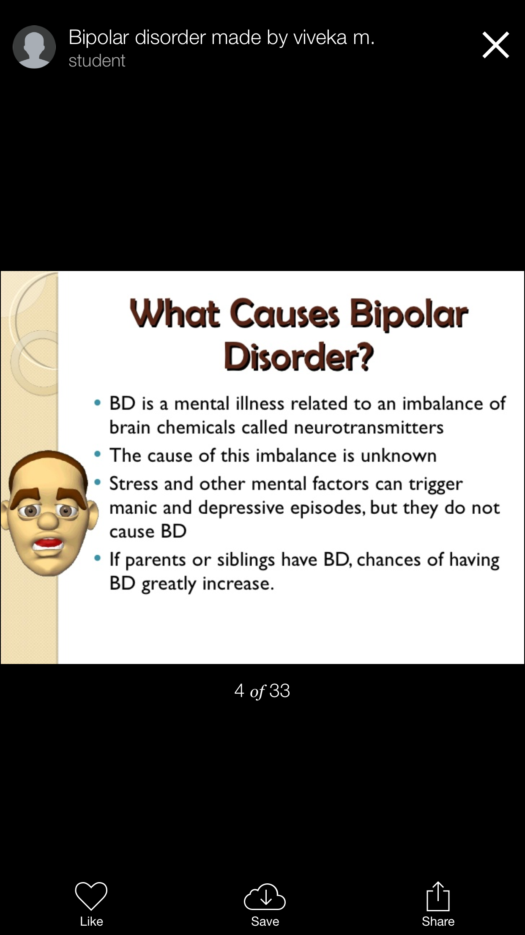

Slide 14
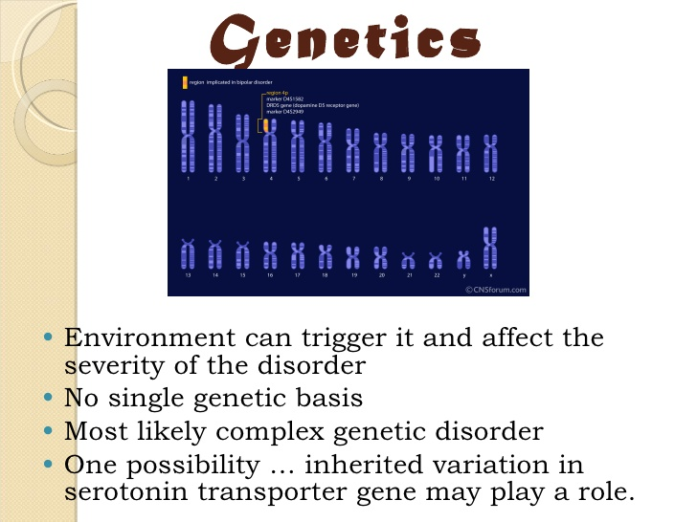

Slide 15
EPIDEMIOLOGY
Common illiness affecting 2% of the world’s population with a lifetime prevalence of 1%
MORTALITY/MORBIDITY
BPD has significant morbidity and mortality rates
Approximately 25-50% of individuals with BPD attempt suicide, and 11% actually commits it.
RACE
No racial predilection
SEX
BPD I occurs equally in both sexes
Incidence of BPD II is higher in females than in male
AGE
The age at onset varies
The age range is from childhood to 50years, with a mean age of approximately 21yeare
The onset of mania in people older than 50years is “red flag”.

Slide 16
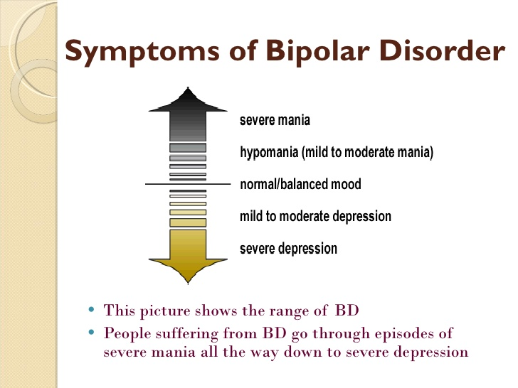

Slide 17
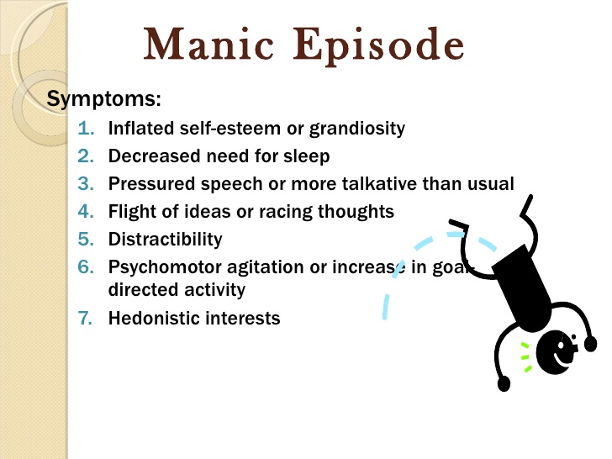

Slide 18
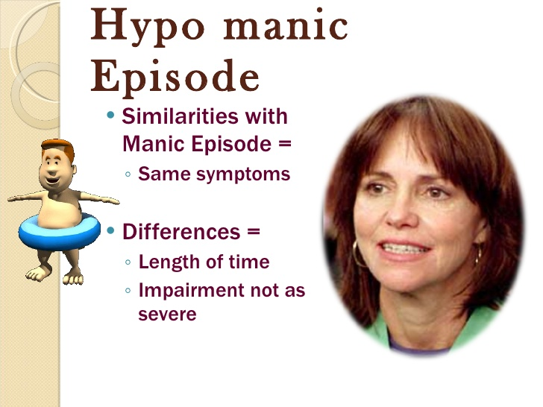

Slide 19
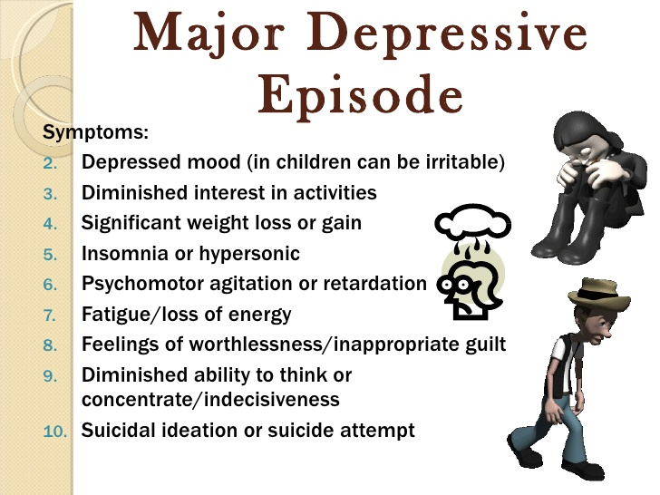

Slide 20


Slide 21


Slide 22
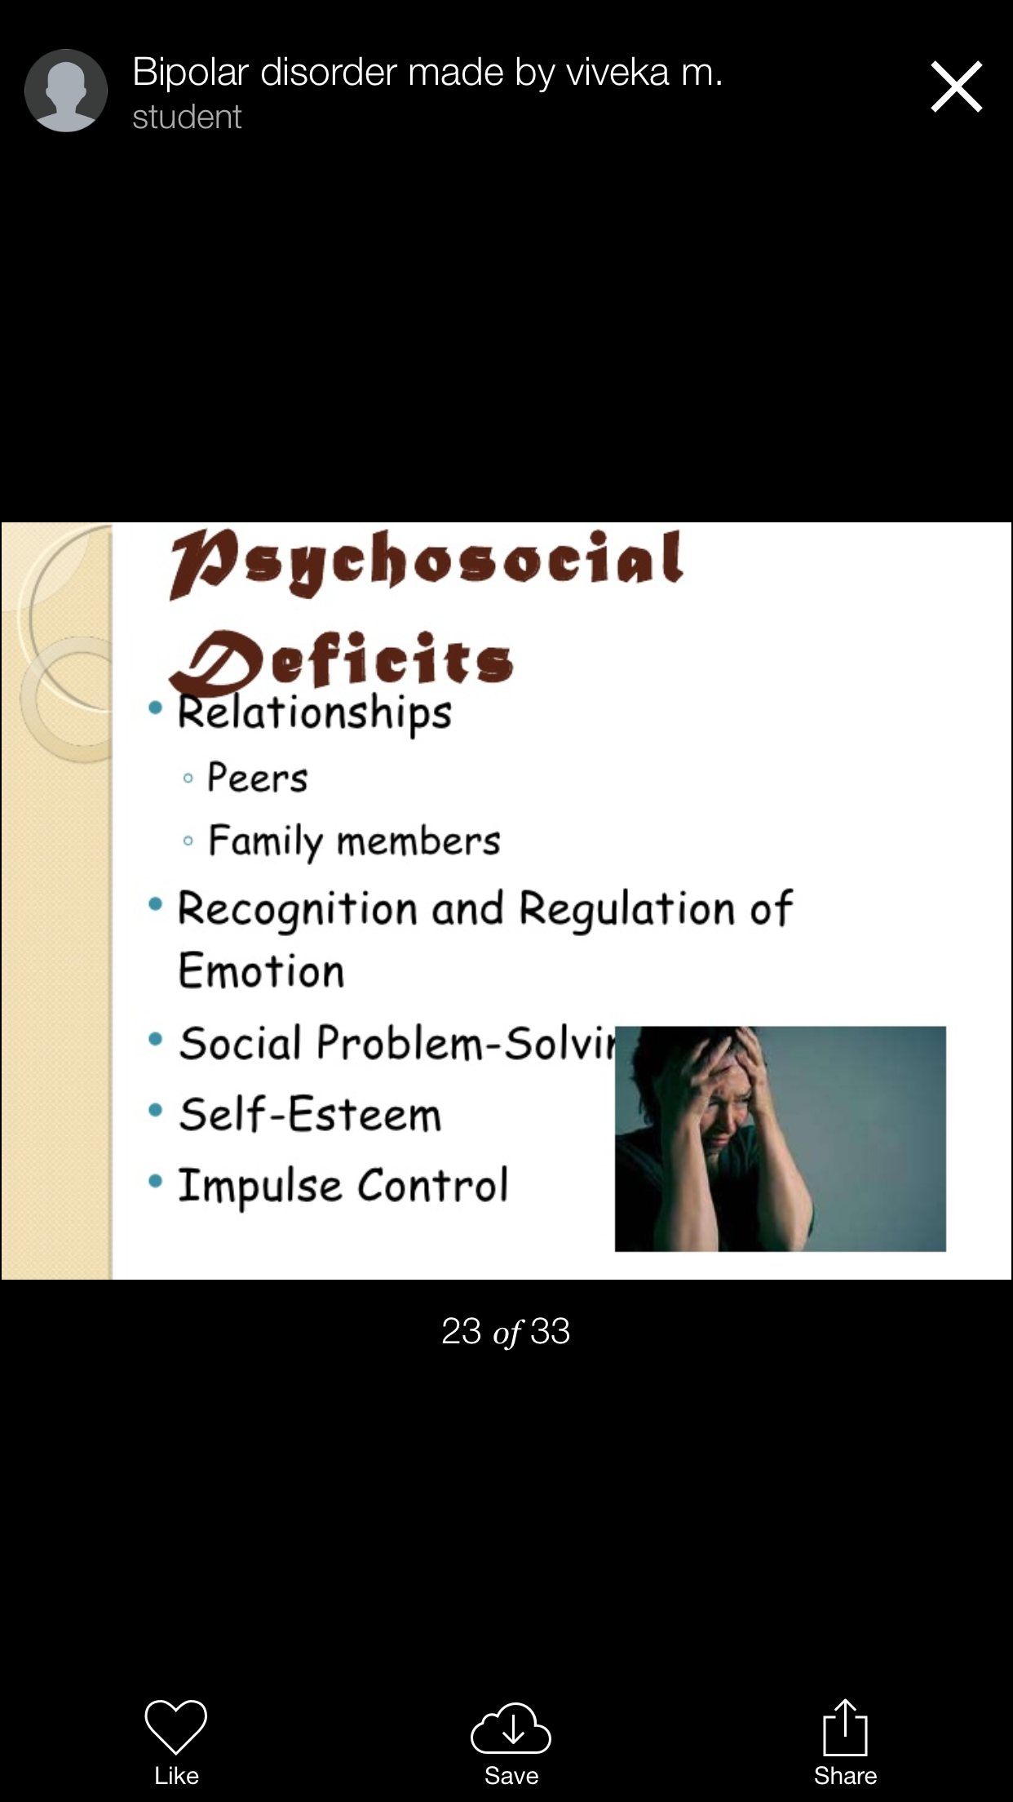

Slide 23
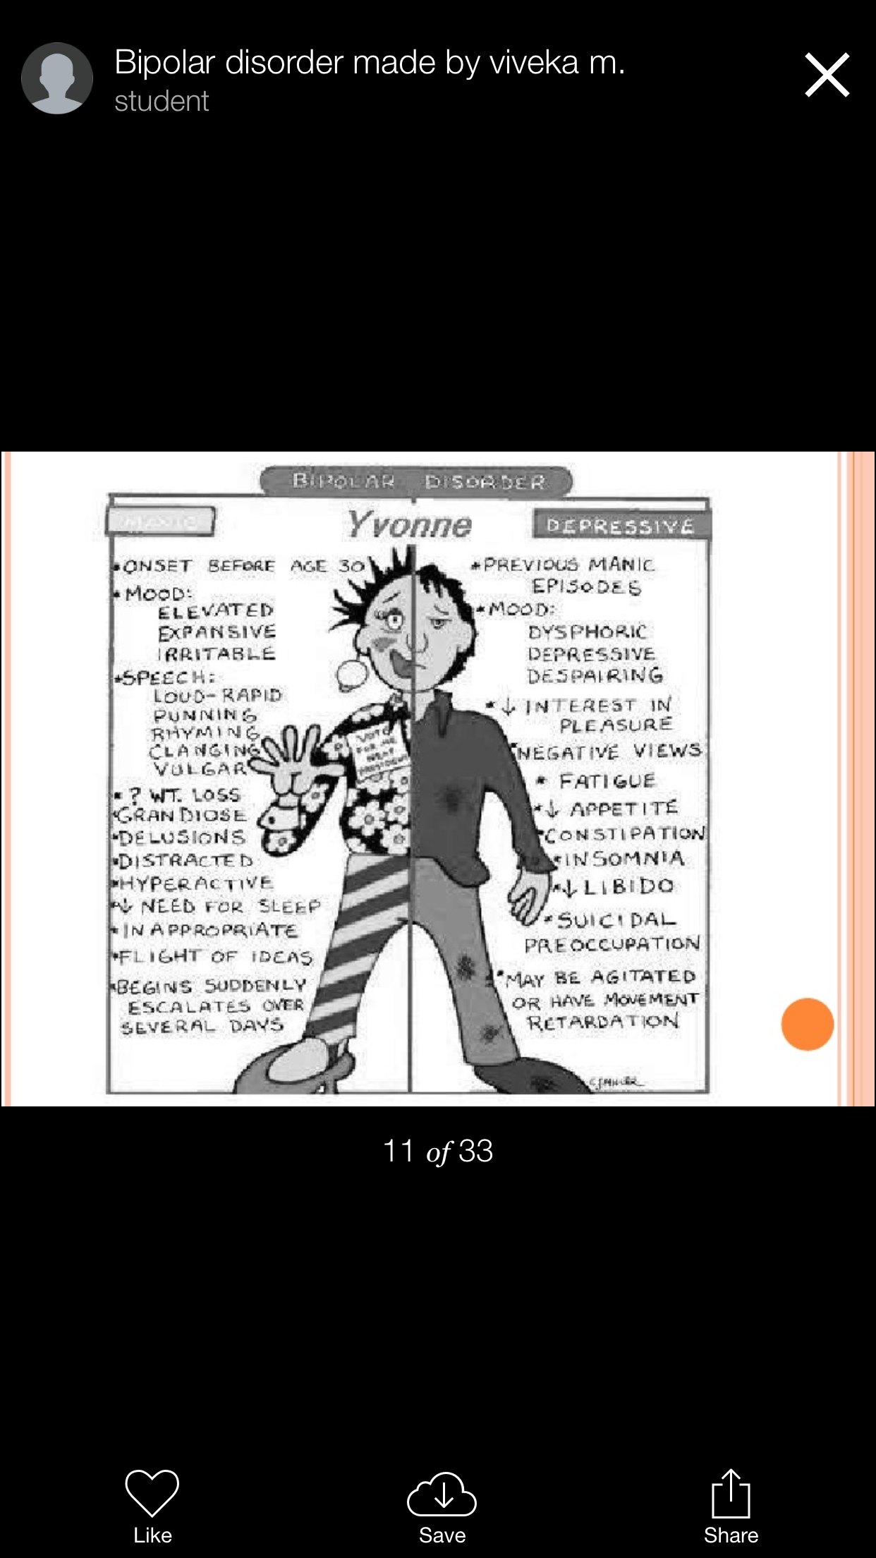

Slide 24
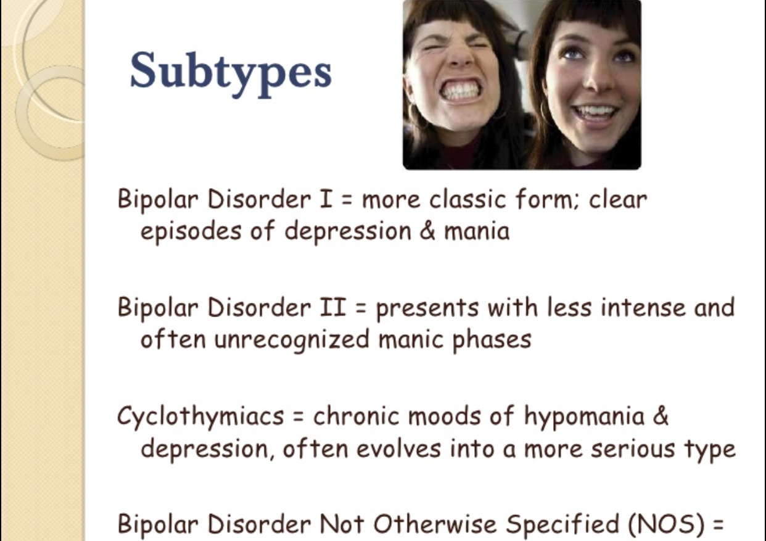

Slide 25


Slide 26
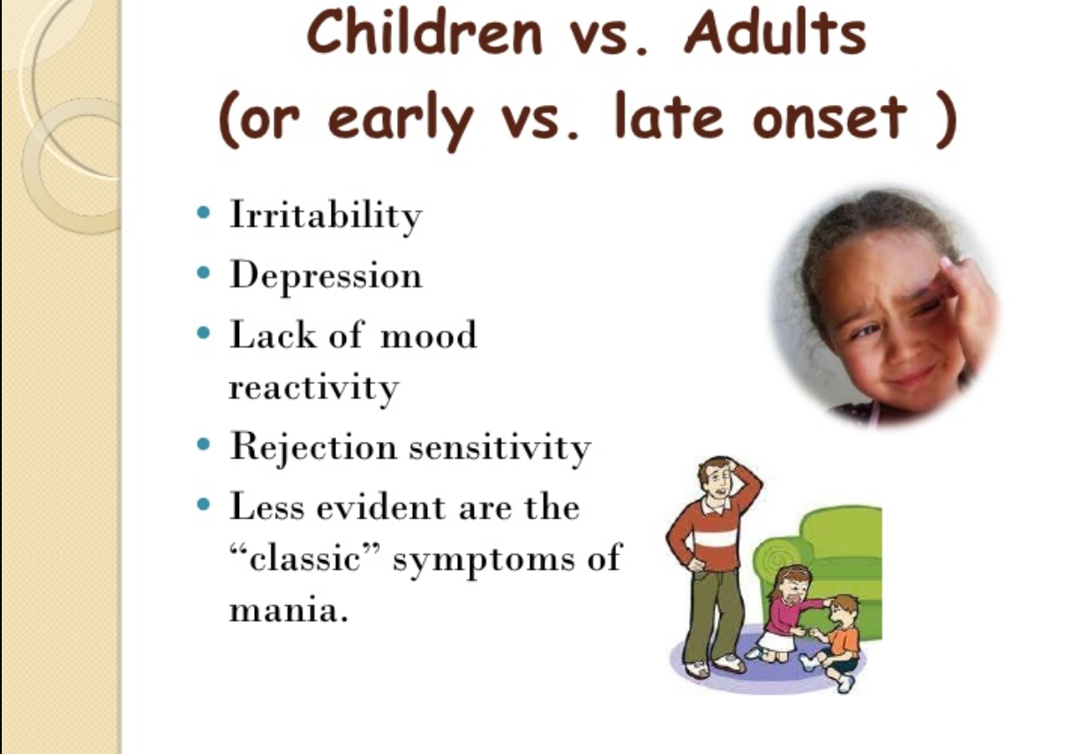

Slide 27
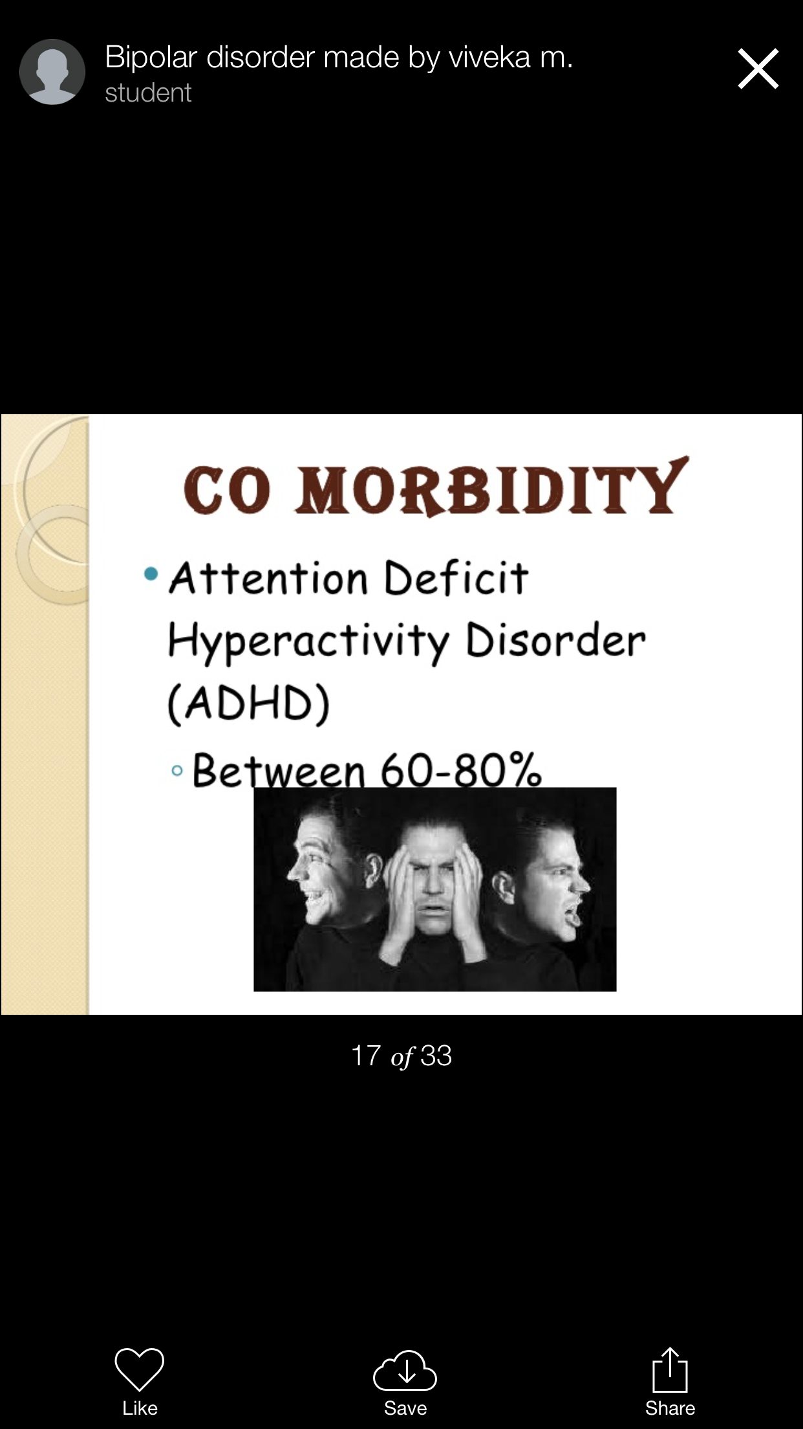


Slide 28


Slide 29
PSYCHOPHARMACOTHERAPY
Mood –stabilizing drugs.
-lithium carbonate-tab-400mg.
-Anticonvulsants (carbamazepine –tab-200mg).
-Antipsychotic agent.
-Benzodiazepines-lorazepam-tab 2 and 3 mg.
-clonazepam-tab 1 and 2 mg.
-Electroconvulsive therapy.
-Antidepressants agents.
-PSYCHOTHERAPY.

Slide 30


Slide 31
PROGNOSIS
Bipolar disorder can be severe and long-term, or it can be mild with infrequent episodes. Patients with the disease may experience symptoms in very different ways. A typical patient with bipolar disorder averages 8-10 manic episodes.

Slide 32


Slide 33
REFERENCES
www.slideshare.net
Medscape

